Slide 1
Introduction to Computer Programming Lecture 6.3:
Intro to the Command Line
Hemma Philamore
Department of Engineering Mathematics

Slide 2
IDE
(Integrated Development Environment)
Spyder, PyCharm, Visual Studio Code…
Combining common activities of writing software in a single application:
Editing (syntax highlighting, autocomplete…)
Running (GUI, program & output within same window)
Debugging (hints and warnings)

Slide 3
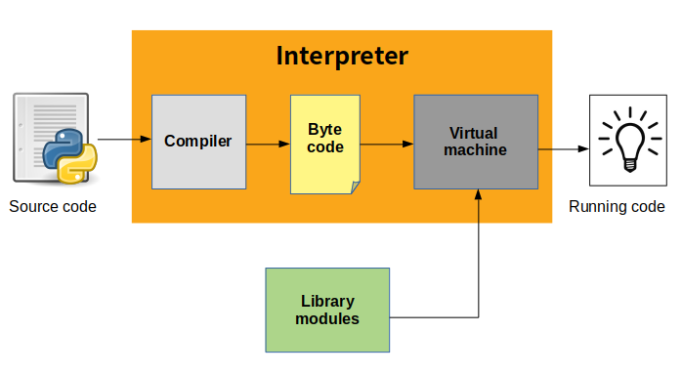
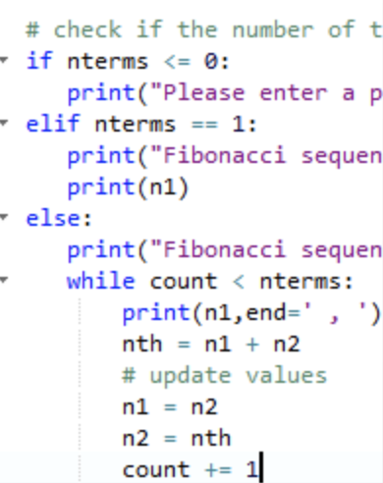
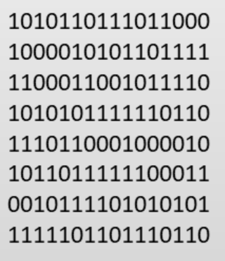
Python
Machine Code

Slide 4
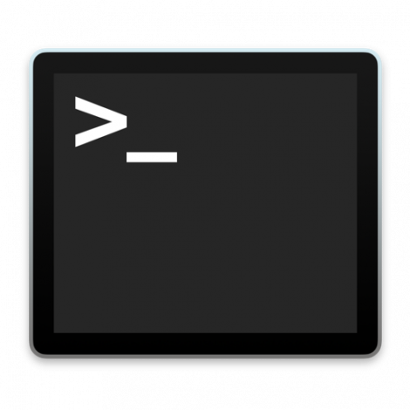
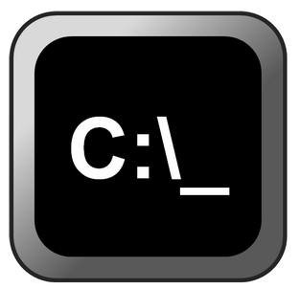
Run python from command line
Terminal (Mac, Linux)
Command prompt (Windows)

Slide 5



Change directory: cd
Run python: python <filename>
remember .py
Documents
5_2
__init__.py
a_program.py
6_2
__init__.py
myClass.py
__init__.py
main.py
user_lib.py

Slide 6
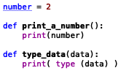
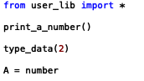

user_lib.py
main.py
a_program.py

Slide 7
PYTHONPATH:
environment variable set before running the Python interpreter.
if it exists, should contain directories that should be searched for modules when using import.
Use a semicolon/colon (depending on OS) is used to separate multiple directories.
To view a list of directories in the Python Path:
Windows
echo %PYTHONPATH%
Mac
echo $PYTHONPATH
Linux
echo $PYTHONPATH
Notes:
https://bic-berkeley.github.io/psych-214-fall-2016/using_pythonpath.html
When importing a package, Python searches through the directories on sys.path looking for the package subdirectory.
Python interpreter automatically creates a list of all of directories it will search for modules when importing.
PYTHONPATH
PYTHONPATH is related to sys.path very closely. PYTHONPATH is an environment variable that you set before running the Python interpreter. PYTHONPATH, if it exists, should contain directories that should be searched for modules when using import. If PYTHONPATH is set, Python will include the directories in sys.path for searching. Use a semicolon to separate multiple directories.
So, in order to import modules or packages, they need to reside in one of the paths listed in sys.path. You can modify the sys.path list manually if needed from within Python. It is just a regular list so it can be modified in all the normal ways. For example, you can append to the end of the list using sys.path.append() or to insert in an arbitrary position using sys.path.insert(). For more help, refer to

Slide 8
Changes to PYTHONPATH are permanent
Changes to sys.path (Lecture 06-2) last for program runtime
Multiple locations separated by ;
Windows
set PYTHONPATH=%PYTHONPATH%;C:\Desktop\folder\sub_folder\
Mac & Linux
export PYTHONPATH= $PYTHONPATH:/ Users/Hemma/Desktop/folder/sub_folder
Multiple locations separated by :
Linux
export PYTHONPATH= $PYTHONPATH:/ Users/Hemma/Desktop/folder/sub_folder
Notes:
https://bic-berkeley.github.io/psych-214-fall-2016/using_pythonpath.html

Slide 9
Summary
cd <directory name> : change directory
cd .. : move one directory back in the file system
dir (windows) ls (mac, linux) : view contents of current directory
python <filename.py> : run python programme
Use tab to autocomplete

